Slide 1
ESA ID: TIAA ALEXA Digital Assistant
PM ID and Name: (611198) Pushparaj R
Review Date: 26/07/2019

Slide 2
Agenda
TIAA Alexa Skill – User Experience
What we did in 2019
Execution Model
Best Practices, Business Ideas & Value-adds
Challenges
2019 Roadmap
Appendix

Slide 3
TIAA Alexa Skill – User Experience
#3

Slide 4
TIAA Alexa Skill – End User / Participant in Digital Assistant Journey
Echo Devices
User acquires Alexa enabled devices such as Echo Dot, Echo show/spot
Download
Echo app
User plugs the Echo device and download the companion app to their phone or tablet
Device
Set Up
User starts the setup process by opening the companion app and connect the Echo device to the internet
Enable TIAA Alexa Skill
User enables the TIAA Alexa skill from the companion app
Voice Interaction
User interacts with Alexa through voice and ask TIAA related queries

Slide 5
TIAA Alexa Skill – End User / Participant in Digital Assistant Journey
Ask TIAA for nearest advisor/office
User gets the location information either from IOT or YEXT services
Ask TIAA for market quote/symbol
User receives the up-to-date stock quote or symbol for the inquired company name
Ask TIAA to play Trivia game
User plays the quiz about TIAA and TIAA related functions
Ask TIAA to get the availability of tax forms
User gets the availability of the following tax form
5498
1099 B, R, Q, INT, DIV and LTC
Ask TIAA for market performance
User receives the up-to-date performance for the inquired market name. i.e. Dow Jones, S&P, NASDAQ

Slide 6
TIAA Alexa Skill
What we did in 2019

Slide 7
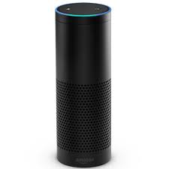
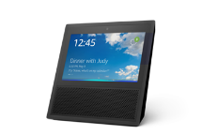

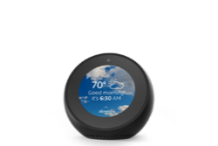

TIAA Alexa Skill – 2019 Delivery Highlights
TIAA Alexa - First Digital Assistant
Amazon Alexa is the voice-activated, interactive AI bot, or personal assistant, that lets people speak with their Amazon Echo devices. TIAA Alexa Skill is the application that gives Alexa the ability to understand the user intents issued in the form of voice commands.
Why:
Voice Experience: Voice is the most natural form. It simplifies the way the user go about every day.
Voice-First Visual Experience: Visuals mainly to complement and supplement the voice UI.
Hands Free: Enables user to communicate being in the place where they are.
Reduce Support Calls: Minimize the customer support calls for basic queries and clarifications
AI Powered Companion: Communication channels have significantly improved with advancements in NLU
Alexa enabled Amazon Echo devices
Impact/Result:
What Cognizant did:
Cognizant was pivotal in the first Digital Assistant of TIAA Alexa.
Provided the document on analysis of the requirement and architecture design for the problem definition
Implemented the test scripts using lambda tester for the incremental changes to rectify the issues in the development stage.
Provided configuration based settings which ease the changes in service endpoints, date ranges and logic parameters
Created mock service to cover the all possible scenario which cannot be done with real time service
Automated the skill intent testing using SMAPI which helps in test the stability of the interaction model at any given time

Slide 8
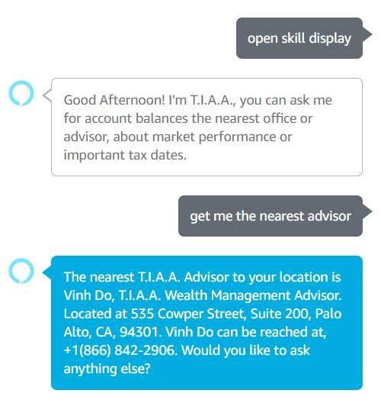
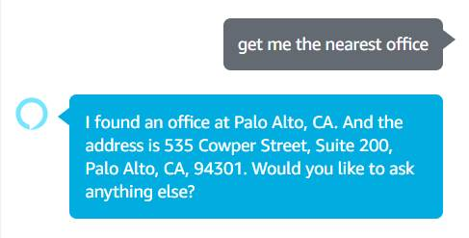
TIAA Alexa Skill – 2019 Delivery Highlights
Integrated YEXT Location Service
February 2019
Additional location services on top of IOT for the nearest advisor
Fetching the advisor/office location from YEXT
Finding nearest advisor/office from YEXT within 20/500 miles radius
Analytics
March 2019
Tagging the user intents and slots via BOOMR analytics
Finding the service call time taken
Passing the session and user details

Slide 9
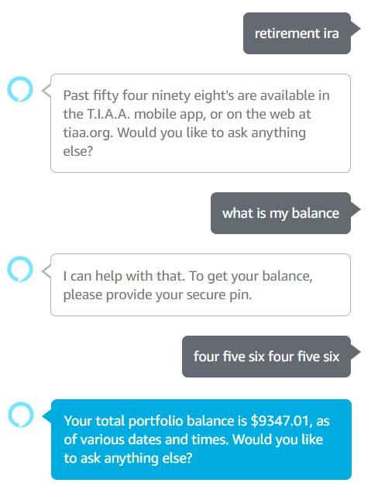
RoboAdvisor – 2019 Delivery Highlights
Responses based on Device Time Zone
April 2019
Retrieval of user device time zone and finding the relative dates.
Forming the tax form availability and market quote response based on date ranges
Included the as of date in the balance inquiry response
Optional Account Linking
May 2019
Enabling the optional account linking for TIAA Alexa Skill
Allowing customers to enable and use your TIAA Alexa skill without first linking their accounts
Requesting for account linking which needs authentication.

Slide 10
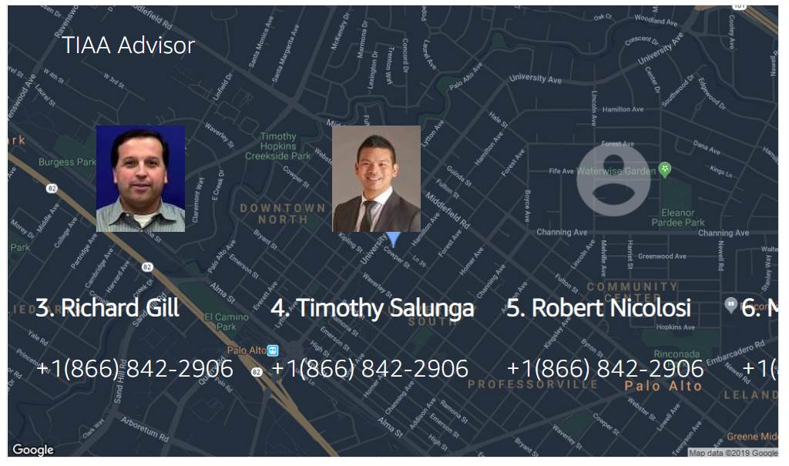
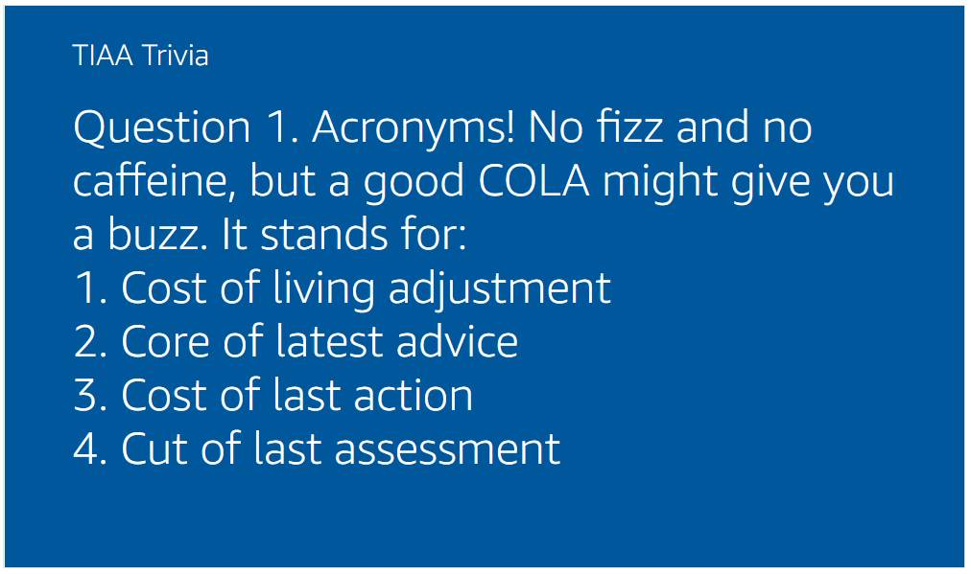
RoboAdvisor – 2019 Delivery Highlights
Designed Alexa skill with Visual Experience
June 2019
Adding Alexa Visual UX for TIAA trivia game.
Introducing the Alexa Visual components for displaying the list of advisors from YEXT
Viewing particular advisor details on touch selection.
Integrating Google Map View in Echo display device
Account Balance Inquiry
July 2019
Secure PIN authentication in the balance inquiry conversation flow
Providing account balance for the Portfolio, Brokerage, Bank, Retirement, Life Insurance, Mutual Funds, Retirement Healthcare, Outside Assets and Trust
Migrated AWS Lambda to TIAA VPC environment.1

Slide 11
Execution Model

Slide 12
TIAA Alexa Skill Platform - Future Release
Release Name | Onsite | Offshore | Nearshore | Current Status | Release changes
August | 1 | 4 | 0 | App Submission | Balance Inquiry with secure PIN conversation flow
Digital Advice Zone
Platform Nature
Business, PM (TIAA)
Followed agile methodologies across the releases
GBS QA involved in August release
Team Alpha
Team Beta
Scrum Team
Scrum Master (CTS)
Scrum Team
Scrum master (CTS)
Development Team Distribution - 5
Dev (CTS)
Dev(CTS)
Onsite
Chennai : 4
Dev(GBS)
Dev(GBS))
QA(GBS)
QA(GBS)
Offshore
UX, Prototype (TIAA)
UX, Prototype(TIAA)

Slide 13
Project Gantt Chart and Current State
August Release Plan
Phases | 14-Jun | 26-Jun | 08-Jul | 13-Jul | 19-Jul | 25-Jul | 30-Jul | 2-Aug | 12-Aug
Design & DEV
QA
UAT
Enterprise Release
Pilot Kickoff
Checkpoint Calls
Pilot Close
App Submission
Go Live

Slide 14
Best Practices, Business Ideas and Value-Adds.

Slide 15
Best Practices
Static Code Analysis
Method of debugging by examining source code before a program is run. It’s done by analyzing a set of code against a set (or multiple sets) of coding rules.
Automated Unit Testing
Unit tests identify issues in the very first stages of the app development cycle. Helps in incremental changes and more flexible with regard to implementing changes in preexisting code
VERACODE Check
Helps find security issues in code and identify code defects that could lead to security issues like SQL Injection, Cross-site scripting, poor cryptography practices, and other issues
Quality
In TIAA, TIAA Alexa Skill is the first project that uses server-less computing platform i.e. AWS Lambda. The lambda then moved to VPC environment for high secure deployment.

Slide 16
Business Ideas & Value Adds
AI based Risk Tolerance Calculator
In the existing risk selection process in RoboAdvisor, the user can either select a risk on his own or he could use the Risk questionnaire(RTQ) feature to get a suggested risk. The purpose of the RTQ is to create an accurate risk profile of the client, which becomes the primary factor in selecting their investments. Yet, it still forces clients to take what amounts to a multiple-choice pop quiz, one for which they have not studied, and relies on their answers to build a portfolio that they may be invested in for decades.
Companies like Yodlee could provide access to an enormous quantity of very useful information about a prospective client. It could include the client’s entire investing history plus their personal finance history, including every transaction they ever made, and throw in social media, too. An algorithm could be written to develop a personality profile for the client that would be a better representation of how they would deal with different market scenarios and provide a better understanding of an investor’s risk profile than a questionnaire.
Business Ideas
Provided configuration based settings which ease the changes in service endpoints, date ranges and logic parameters.
Achieved hiding the user secure PIN information in the Balance Inquiry conversation flow as part of security aspects.
Automated unit test scripts helped in ensuring the bug free code prior to code deployment.
Provided for both Voice and Visual experiences which covers the usage of both Echo and Echo display devices.
Value Adds

Slide 17






TIAA Alexa Team – Other Metrics
Highlights
Team is continuously doing research on latest trend in Amazon Alexa and shares comparative study in TIAA perspective.
Research & Development
CCA Status
CCA Status – Alexa : On Track for CCA target.
GBS Knowledge Sharing
CII contribution
Release Support
Continue to support and provide KT sessions (Business & Application Knowledge) to the GBS resources
Soft Dollar Savings : 3 Value-Adds, $35K
Offshore team continued to provide support for production releases

Slide 18
Challenges

Slide 19
Challenges
GBS owns the QA execution and Cognizant don’t have any involvement. Since GBS QA’s business knowledge is limited, dev team actively support QA.
Cognizant offshore performs the dual role of Development and Technical lead. There were challenges initially in assigning the work to GBS. But Onsite worked with TIAA managers to sort out the issues.
GBS
Collaboration

Slide 20
2019 Roadmap

Slide 21
Digital Advisor Road Map 2019
Alexa 2019
Sep 2019
Nov 2019
Alexa Skill Submission for certification
Support for Balance Inquiry secure PIN conversation flow.
Echo Show UX for office.
Transaction Use Cases
Tech Pipeline for 2019
Node 10.X upgrade.
Automate the interaction model utterance profiler testing.
Mock service creation for the new service in the future.
Setup Sonar Cube environment for automating the code quality and coverage check

Slide 22
Previous Review – Actionable Status
# | Actions | Review Date | Responsibility | Target Date | Actual Closure Date | Status | Remarks

Slide 23
Accolades
Blandford, Scott M, EVP, Chief Digital Officer after TIAA Alexa Skill release
FANTASTIC step forward!!!
Weil, Lisa, MD, after TIAA Alexa SKill release Great milestone - congrats to this awesome team!!
Porter, Zsa-Zsa , Sr Dir, Digital Product Management, TIAA
“I am excited to announce that our Alexa Skill is now LIVE in the Amazon Marketplace! With the new skill, users can find local TIAA advisor, get a market quote, and find important tax information. A big THANK YOU to the entire Alexa pilot team for making this idea a reality.”

Slide 24
Appendix
#24
Notes:
All screenshots – Add one liner about on the respective slide.

Slide 25
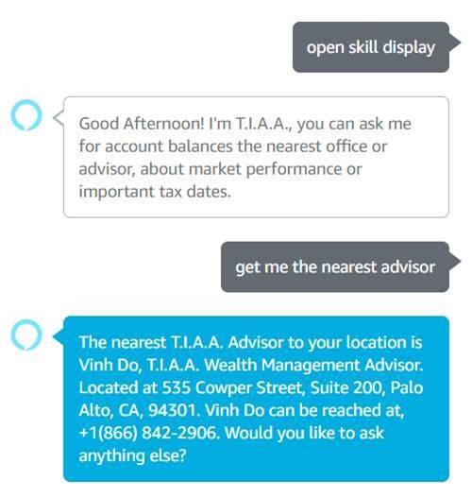

TIAA nearest advisor / office Conversation Flow
Screenshots (if any)

Slide 26
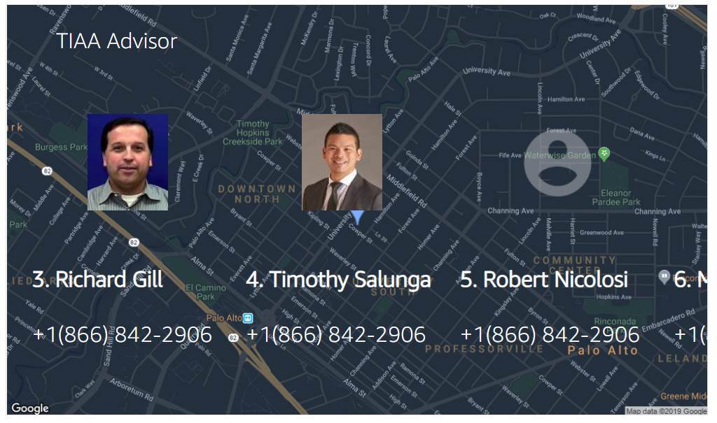
TIAA nearest advisor list view from Echo Show
Screenshots (if any)

Slide 27

TIAA Trivia Question view from Echo Show
Screenshots (if any)

Slide 28
TIAA Tax form availability & Balance Inquiry Conversation Flow
Screenshots (if any)

Slide 29
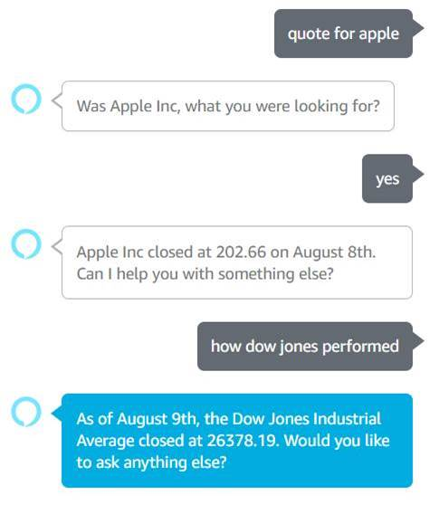
TIAA Market Quote and Performance Conversation Flow
Screenshots (if any)

Slide 30
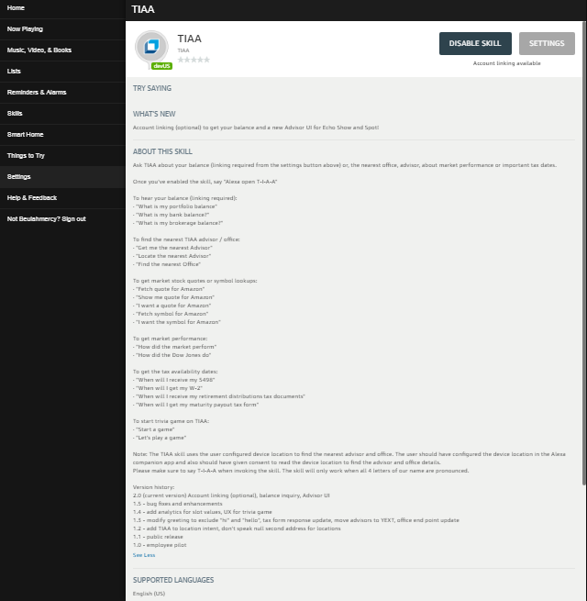
TIAA Alexa Skill – Web Companion App
Screenshots (if any)

Slide 31
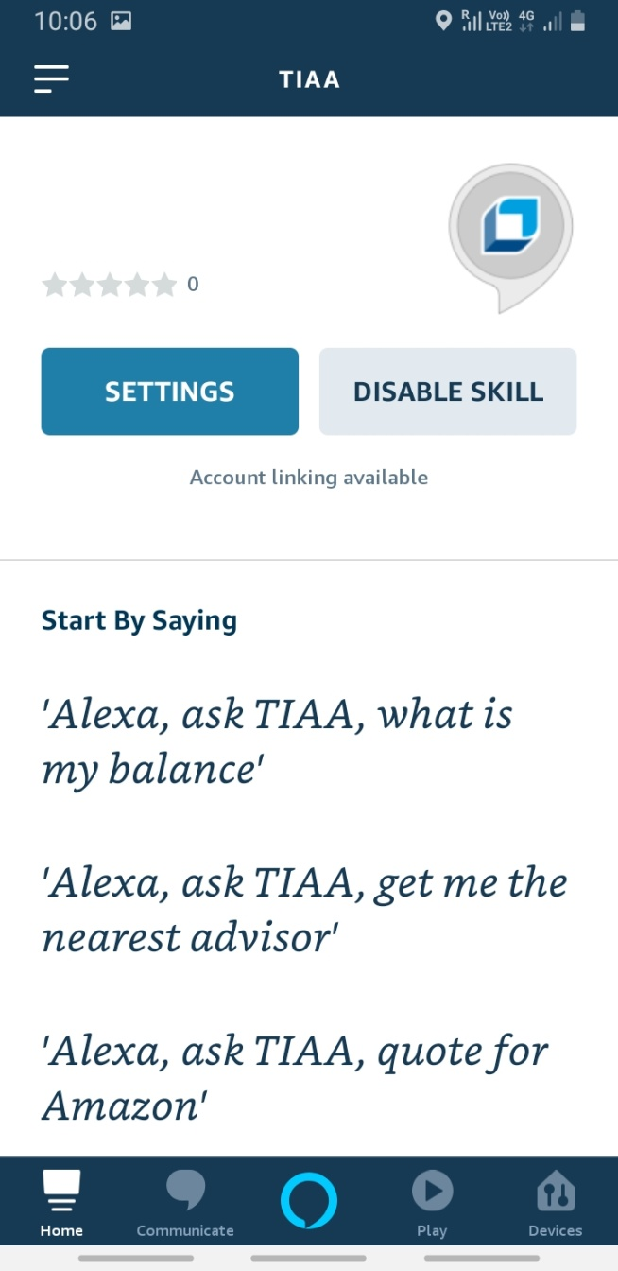
TIAA Alexa Skill – Mobile Companion App
Screenshots (if any)

Slide 32
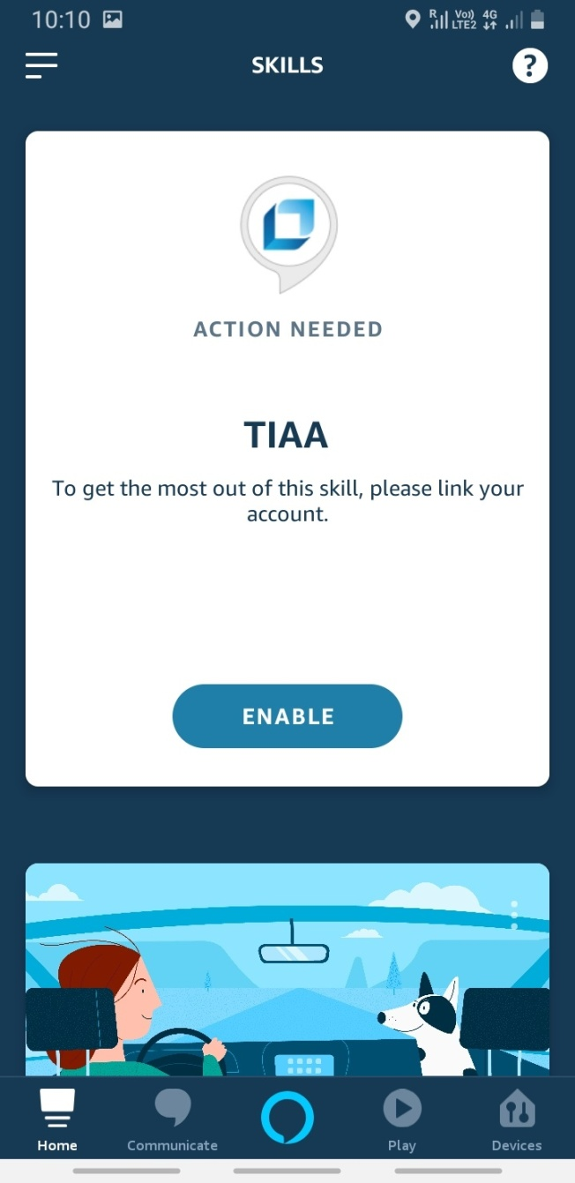
TIAA Alexa Skill – Mobile Companion App – Linking Account
Screenshots (if any)

Slide 33
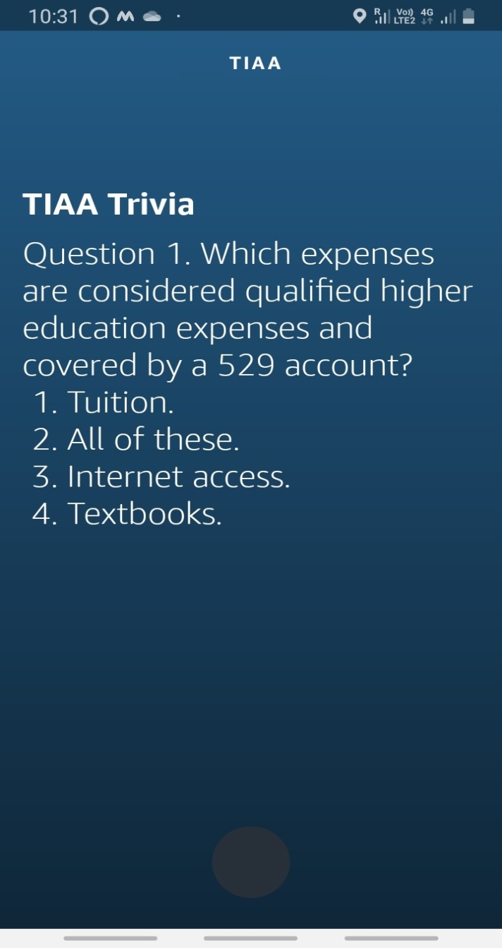
TIAA Alexa Skill – Mobile Companion App – Trivia
Screenshots (if any)

Slide 34
Thank You!

